Slide 1
Probability and statistics 11-Frequentist Statistics
상명대학교 휴먼지능정보공학과

Slide 2
Frequentist school of statistics
Dominant school of statistics in the 20th century.
p-values, t-tests, χ²-tests, confidence intervals.
Defines probability as long-term frequency in a repeatable random experiment.
Yes: probability a coin lands heads.
Rejects the use of probability to quantify incomplete knowledge, measure degree of belief in hypotheses.
No: prior probability for the probability an unknown coin lands heads.

Slide 3
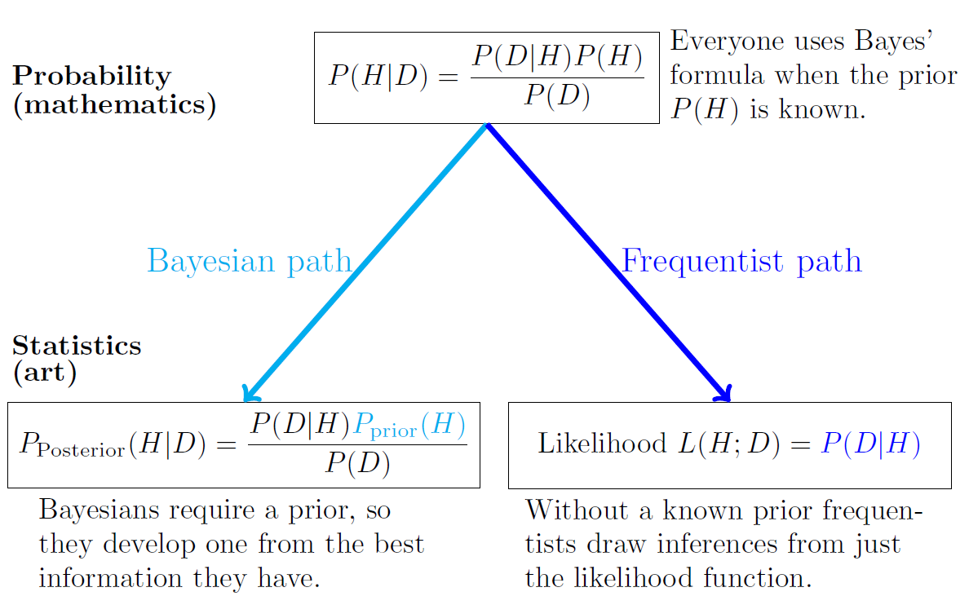
Difference between Bayesian & Frequentist

Slide 4
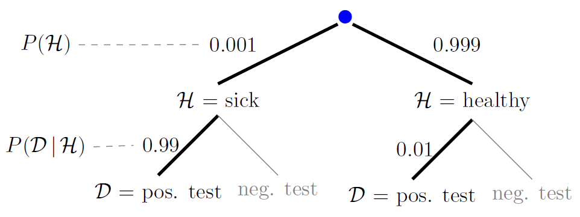
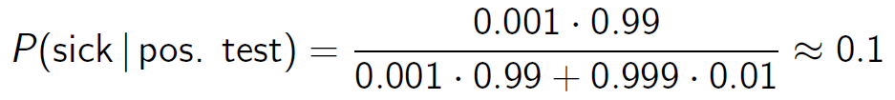
Disease screening recap: probability의 경우
The test is positive. Are you sick?
The prior is known so we can use Bayes’ Theorem.

Slide 5
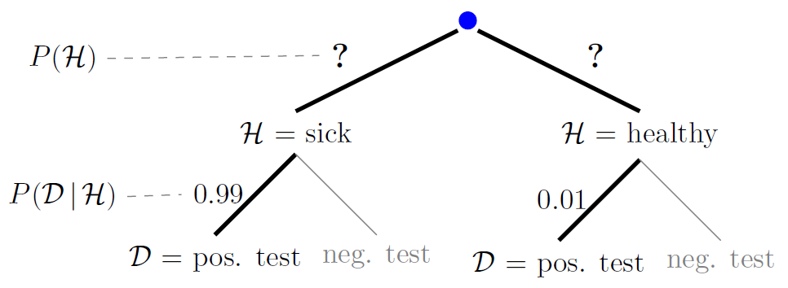
Disease screening recap: statistics
The test is positive. Are you sick?
The prior is not known.
Bayesian: use a subjective prior P(H) and Bayes’ Theorem.
Frequentist: the likelihood is all we can use: P(D|H)

Slide 6
Statistics are computed from data
Definition: A statistic is anything that can be computed from random data.
A statistic cannot depend on the true value of an unknown parameter.
A statistic can depend on a hypothesized value of a parameter.
Examples of point statistics
Data mean
Data maximum (or minimum)
Maximum likelihood estimate (MLE)
A statistic is random since it is computed from random data.
We can also get more complicated statistics like interval statistics.

Slide 7

Statistics are computed from data
Suppose x1,..., xn is a sample from N(μ, σ²), where μ and σ are unknown.
Is each of the following a statistic?
1. The median of x1,..., xn.
2. The interval from the 0.25 quantile to the 0.75 quantile of N(μ, σ²).
3. The standardized mean .
4. The set of sample values less than 1 unit from .

Slide 8
Statistics are computed from data
Suppose x1,..., xn is a sample from N(μ, σ²), where μ and σ are unknown.
Is each of the following a statistic?
1. The median of x1,..., xn. → Yes
2. The interval from the 0.25 quantile to the 0.75 quantile of N(μ, σ²). → No. The interval only depends on μ and σ.
3. The standardized mean . → No
4. The set of sample values less than 1 unit from . → Yes

